Slide 1
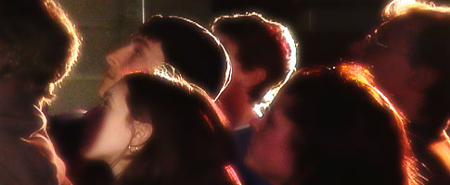
To Invite and challenge youth to a lifelong journey in relationship with Christ and His Church
Dynamic Relationships Challenging Experiences

Slide 2
C
E
L
E
B
R
A
T
I
N
G
50!

Slide 3
Overview, update, and challenges

Slide 4
Ministry Integration
Adventures
Wilderness River & Mountain Expeditions
Stonewater Base Adventure Combinations
Team Building & Leadership Challenges
Leadership
Life & Leadership Discipleship Training for High School
Ministry & Technical training for Young Adults
On & offsite Leadership Development for outside groups
Retreats
Self managed Youth and Family Retreats
Leadership Teams and Adult groups
Retreats with Facilitated Adventures

Slide 5
Stats
15 Full & Part Time Staff
8-16 Summer Staff
20-40 Volunteer Staff
224 Groups
4k Participants
11k Contact days
I loved the way the staff immediately got involved with the kids as soon as they arrived and naturally mingled into the various groups of kids! They were so encouraging to all the kids and I was grateful for their vulnerability and honesty in sharing their testimonies. ~ Omak Landing youth ministries
We had a few students, who although they are not religious, felt open to the idea of exploring their faith after their time at Stonewater. You team was a safe and open place to experience God in a new way! ~ Act Six leaders

Slide 7
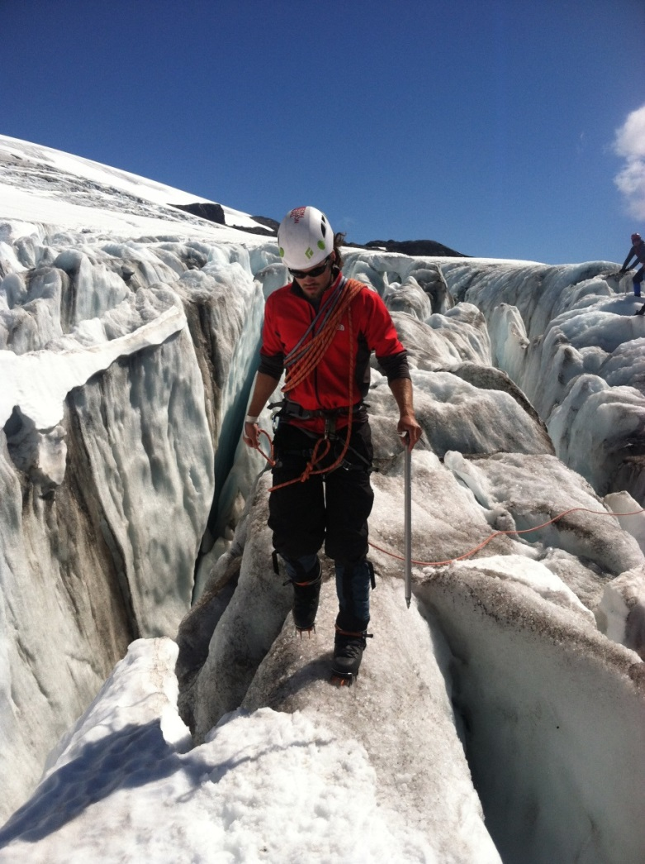
CREATED FOR ADVENTURE
God has wired us so that our bodies, minds, and spirits require challenge, and we flourish especially when we face challenges for a cause greater then ourselves. We experience the flow of the Spirit most deeply when we focus on challenges that enrich the community and when we cease to be preoccupied with our own advancement.
Jon Ortberg

Slide 8
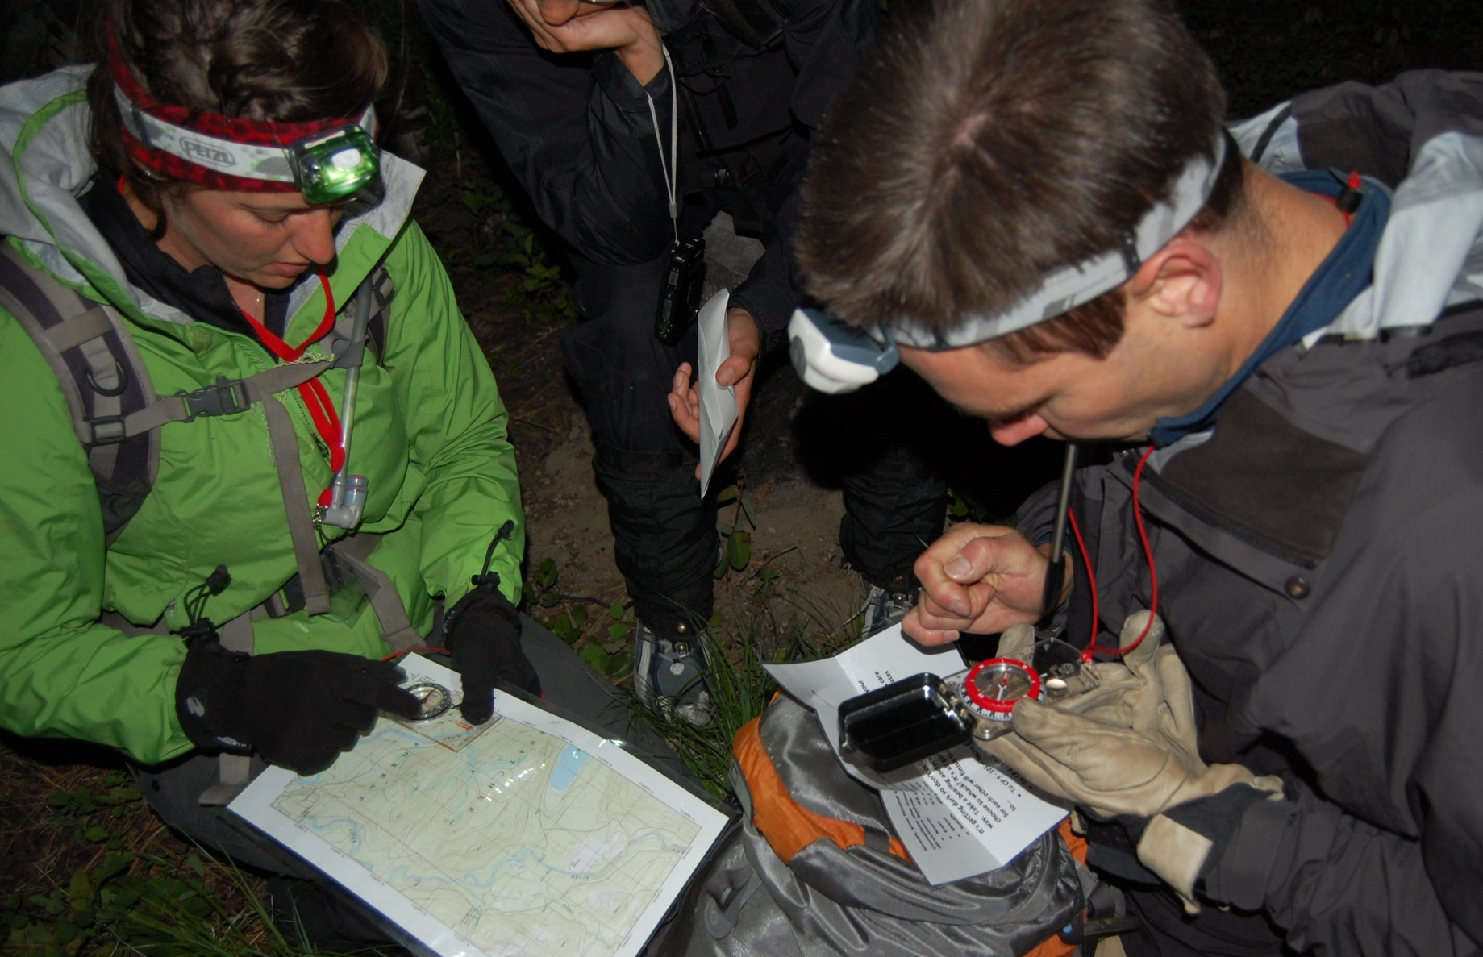
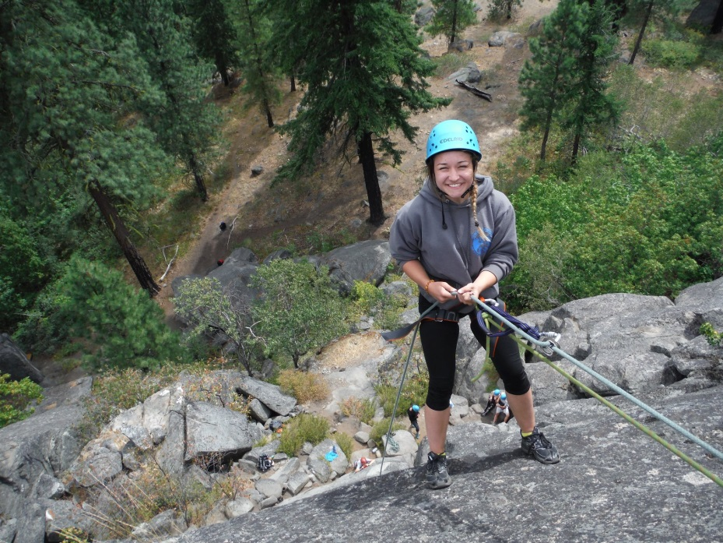
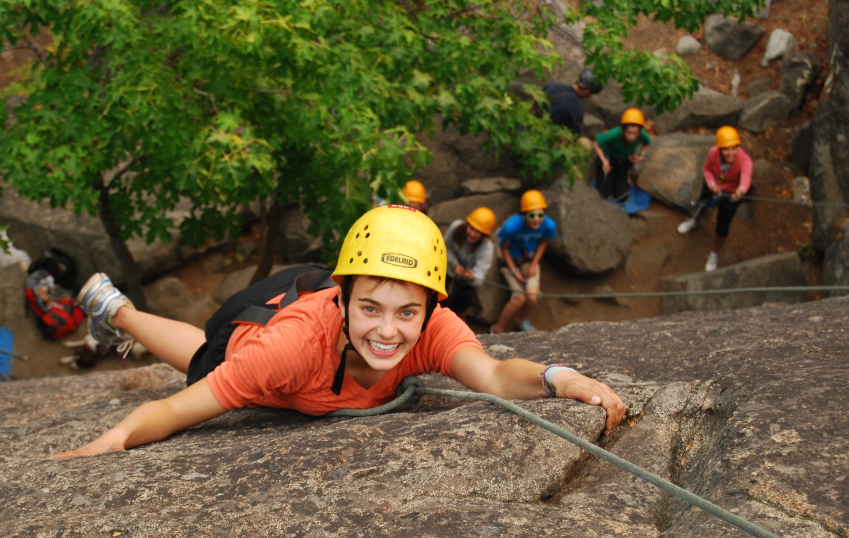
Creating Space
To Build Trust

Slide 9
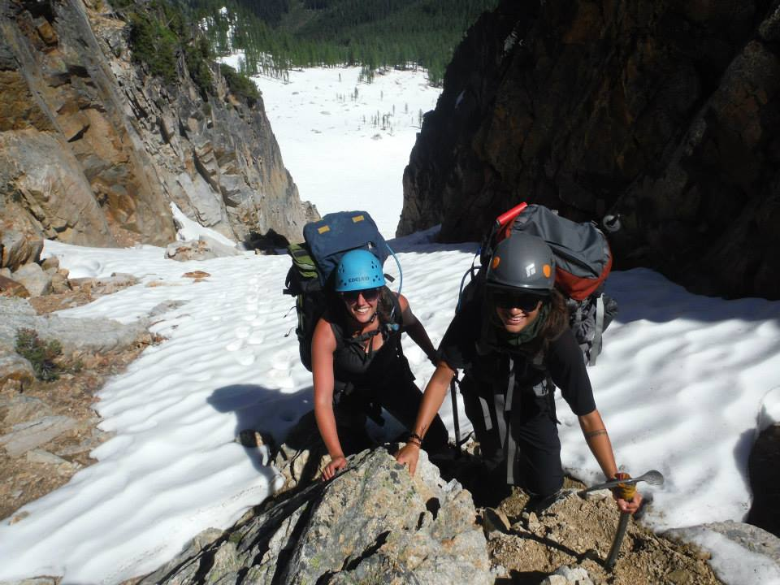
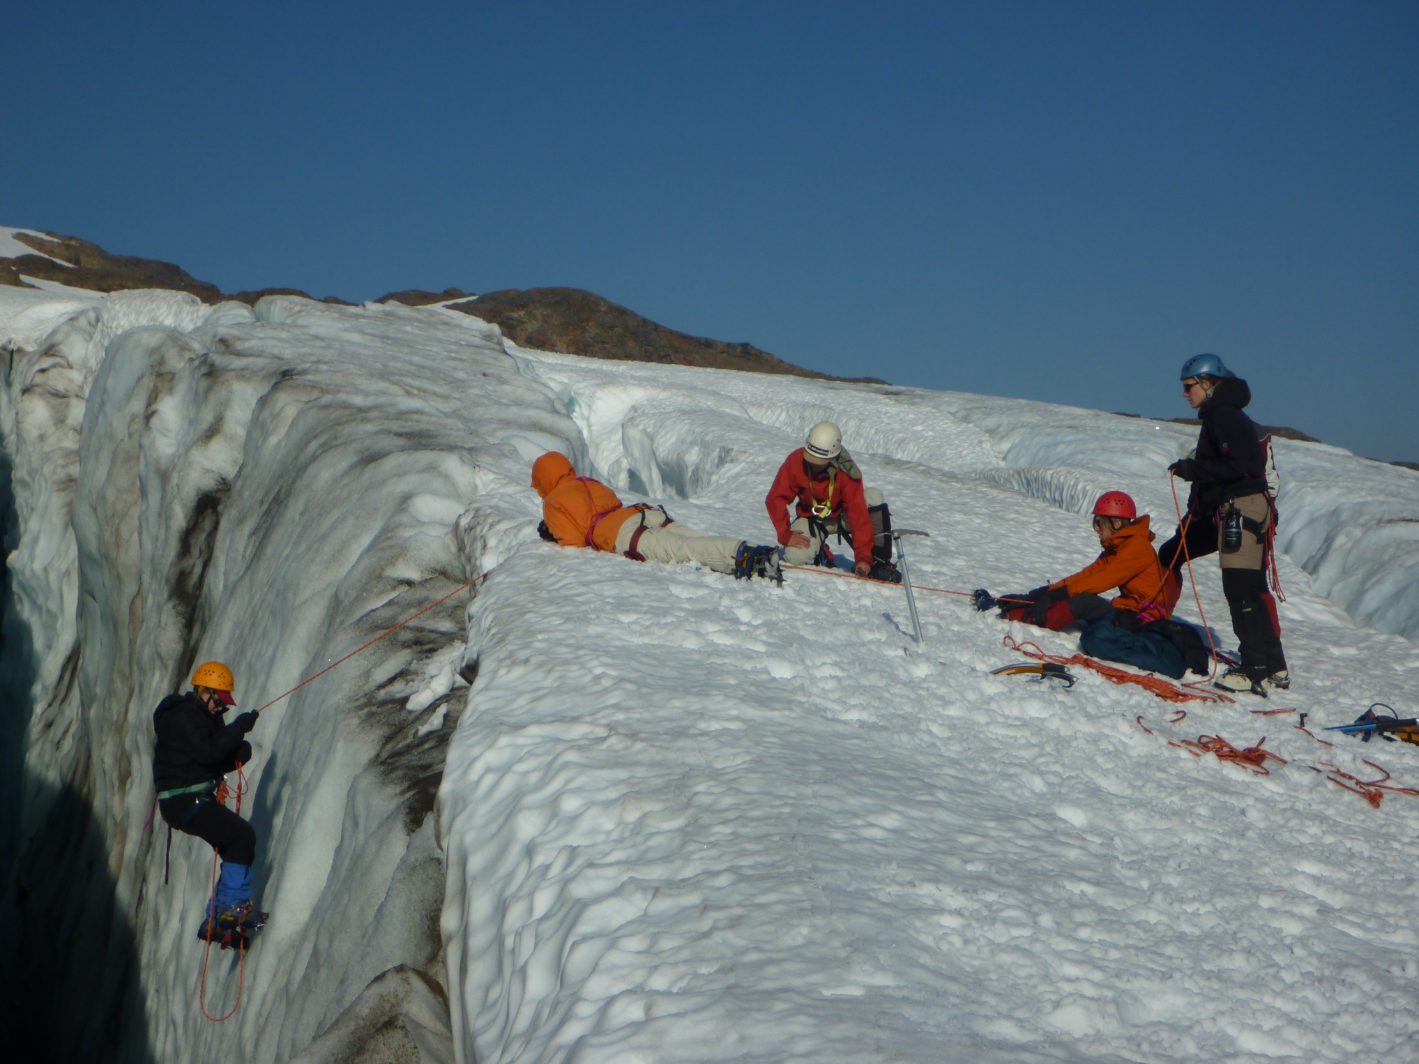
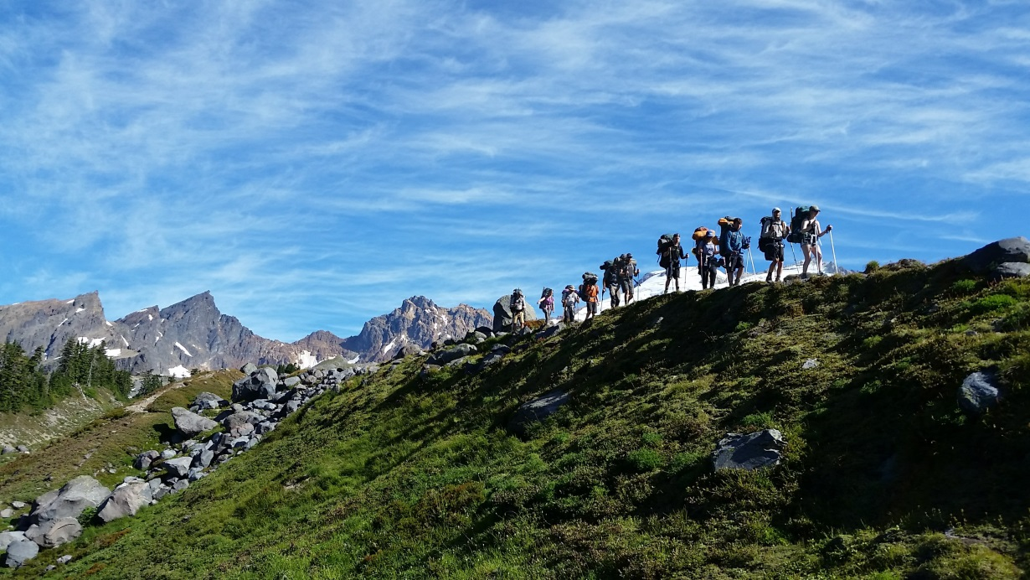
Experiences Build Relationships

Slide 10
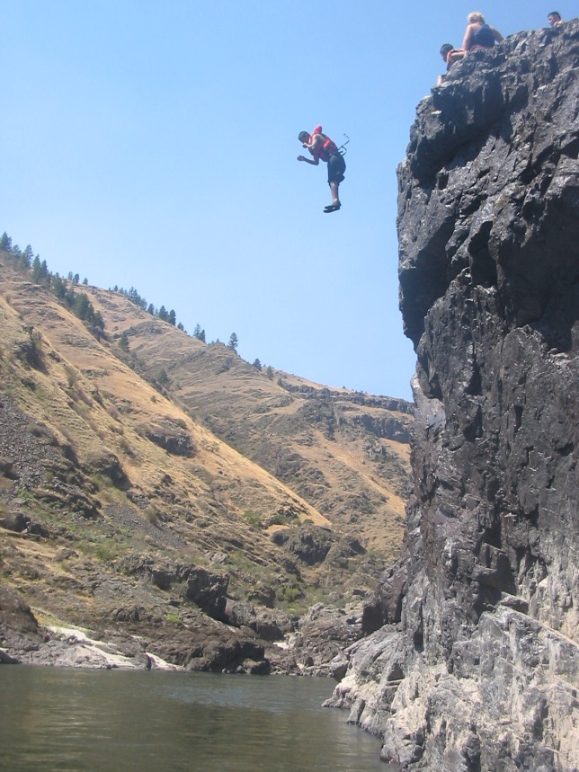
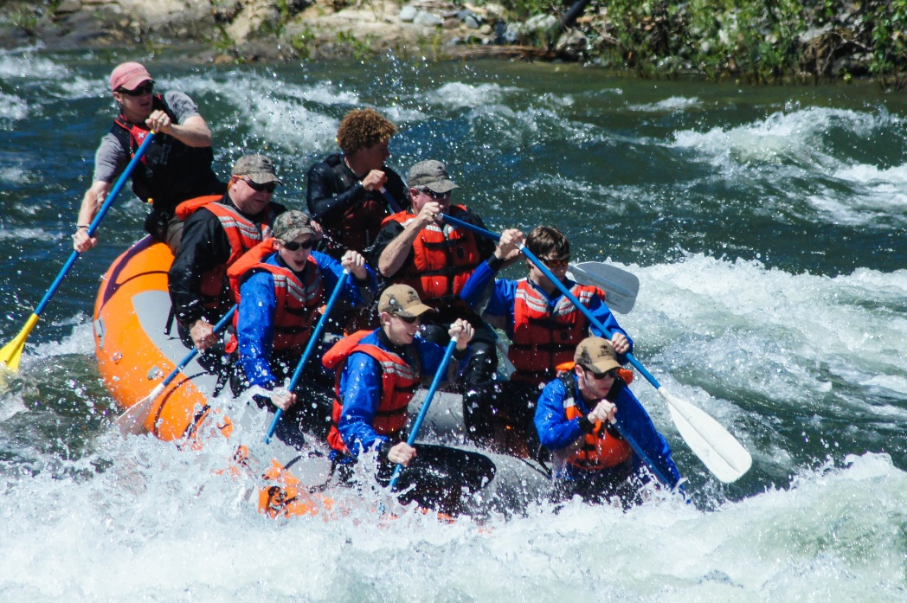
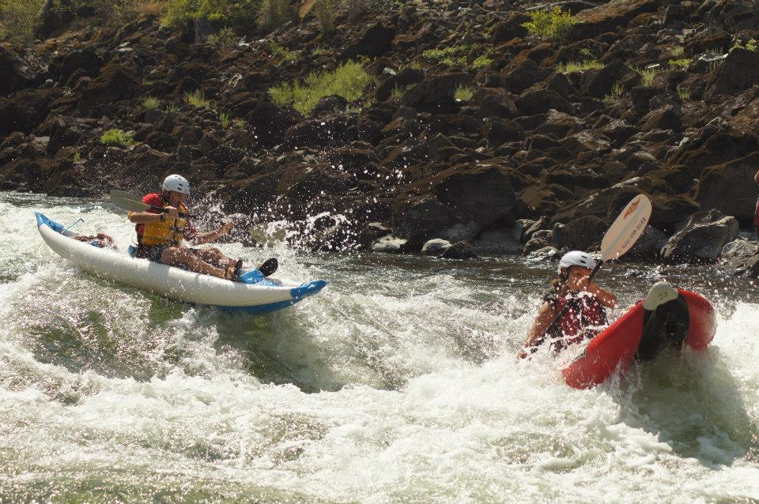
Working Together

Slide 11
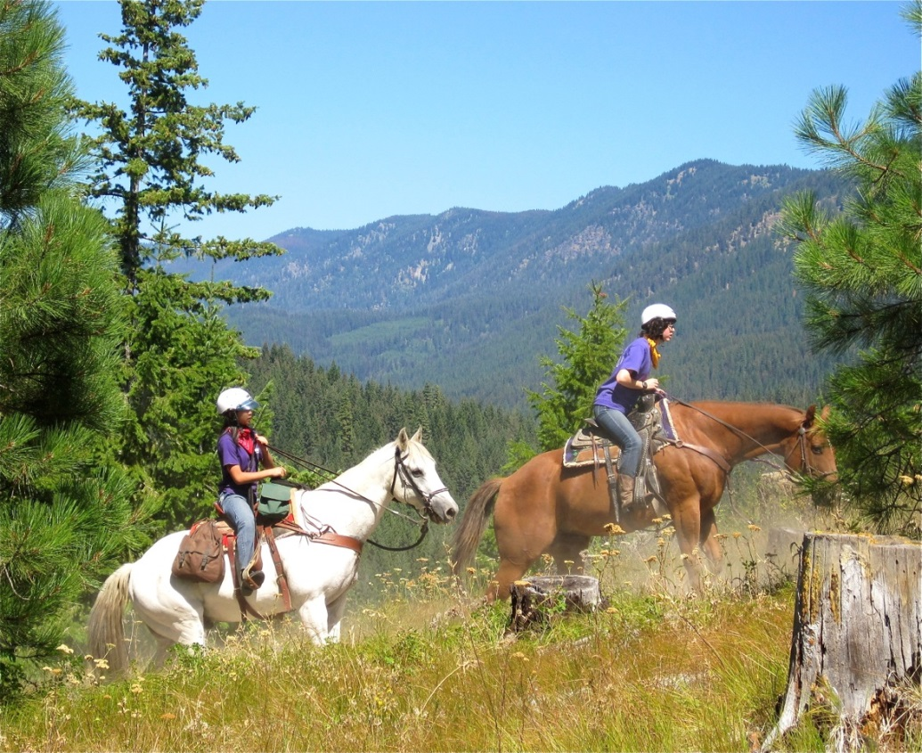
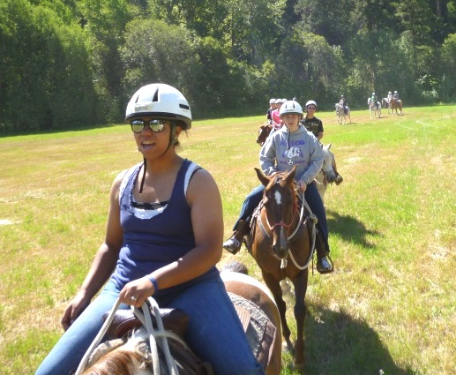
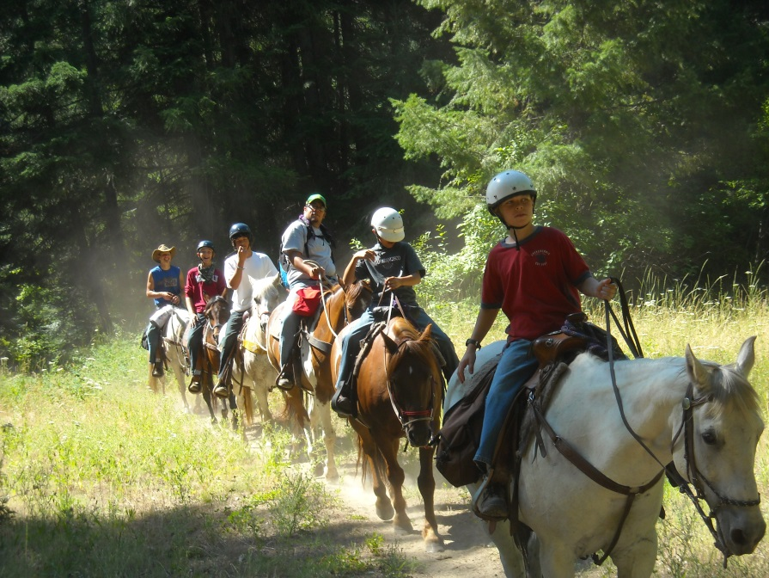
Horsing around!

Slide 12
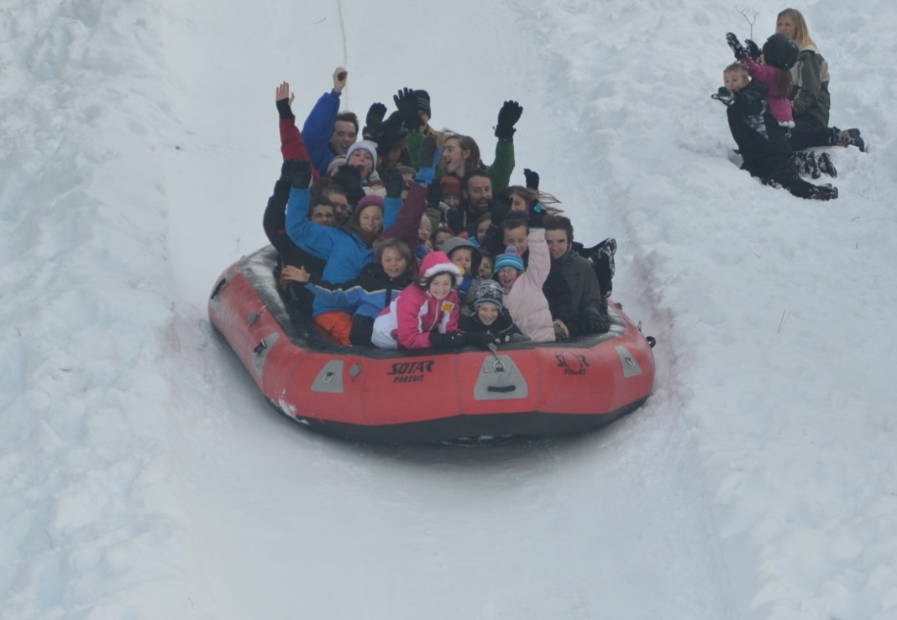
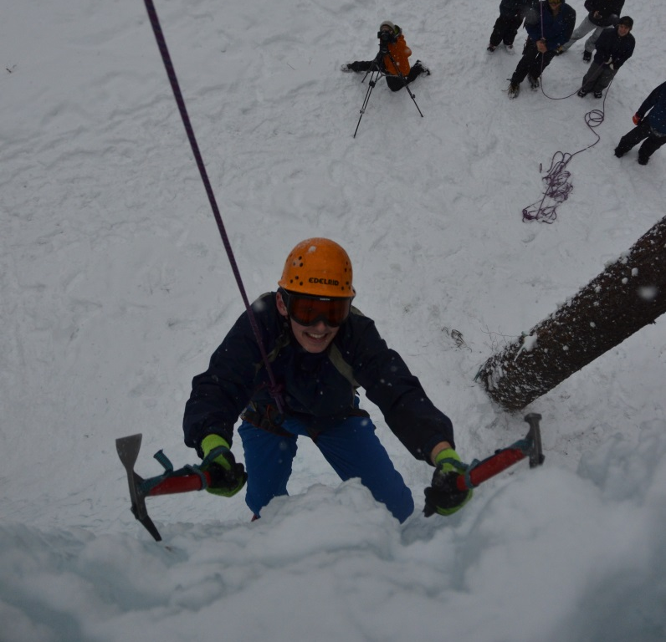
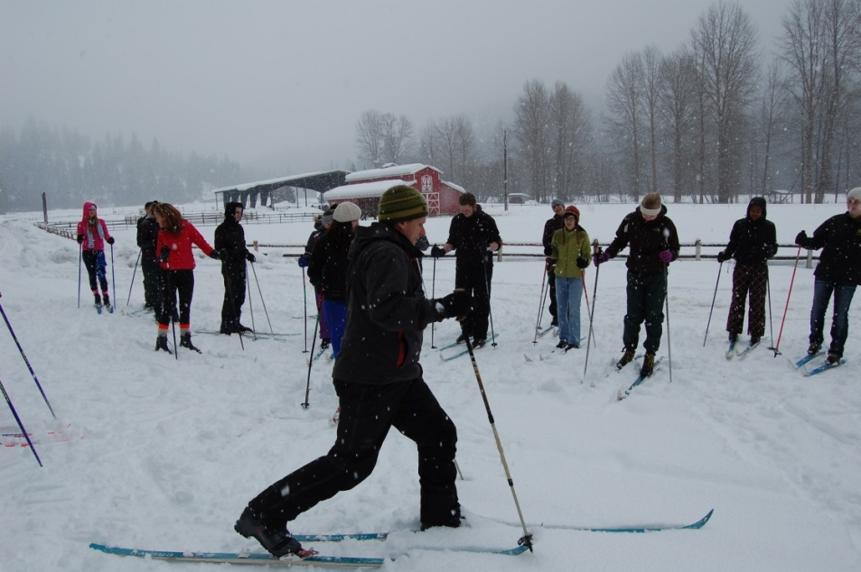
Getting Unplugged

Slide 13
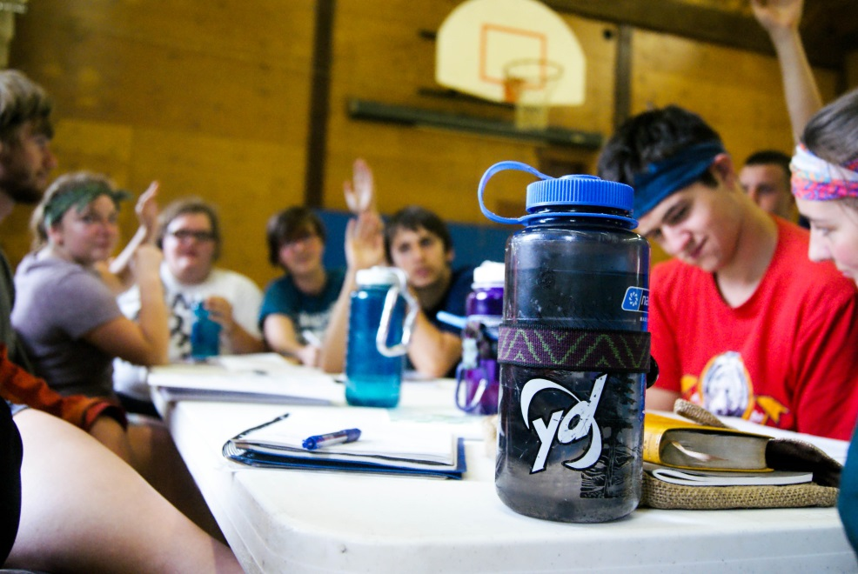
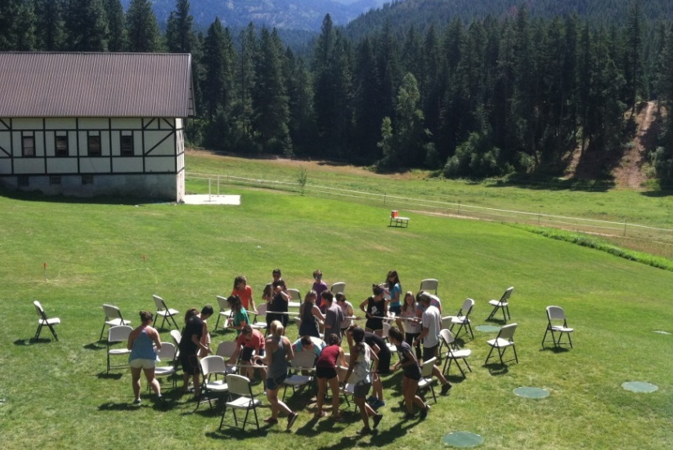
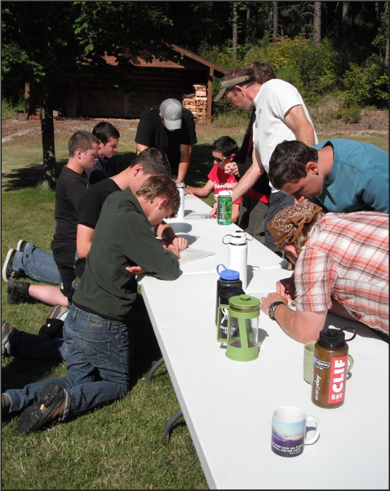
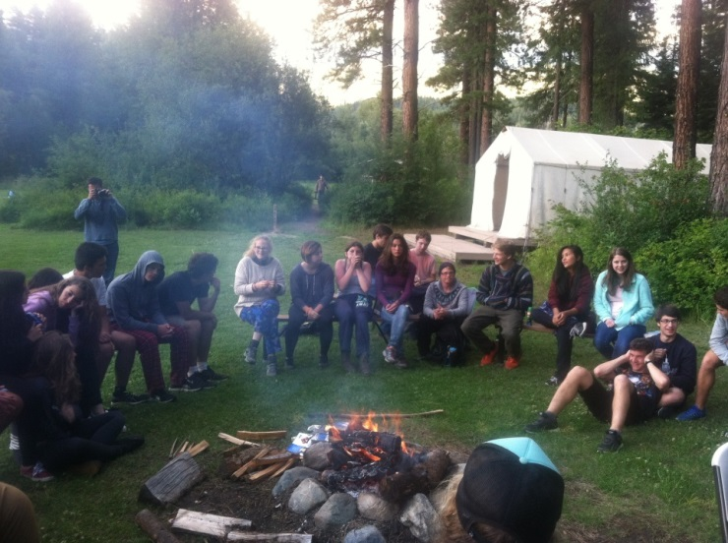
Leadership Development

Slide 14
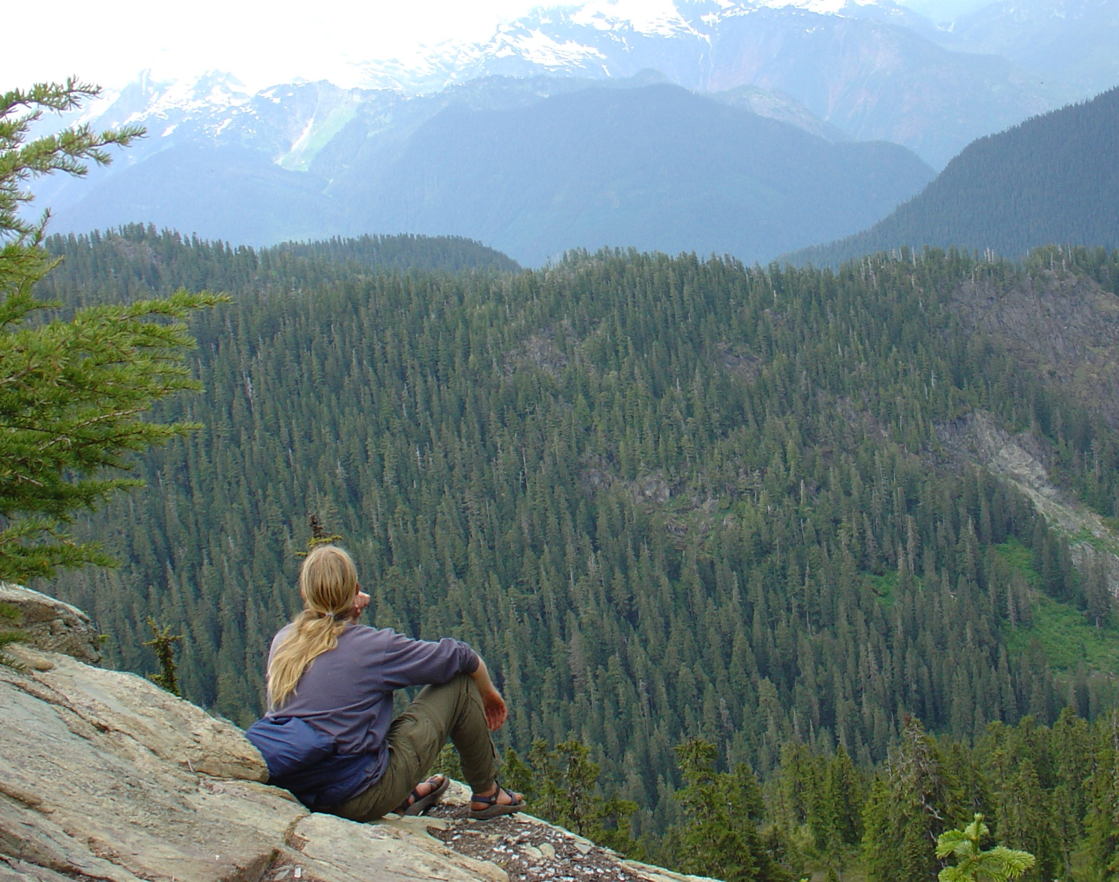
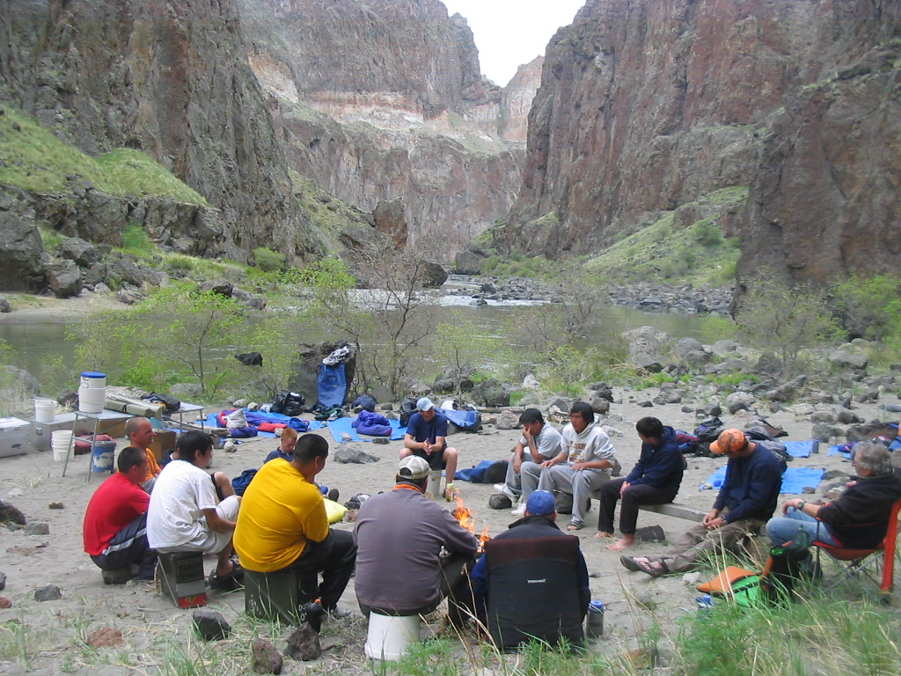
CREATING SPACE FOR GOD
Process time and reflection

Slide 15
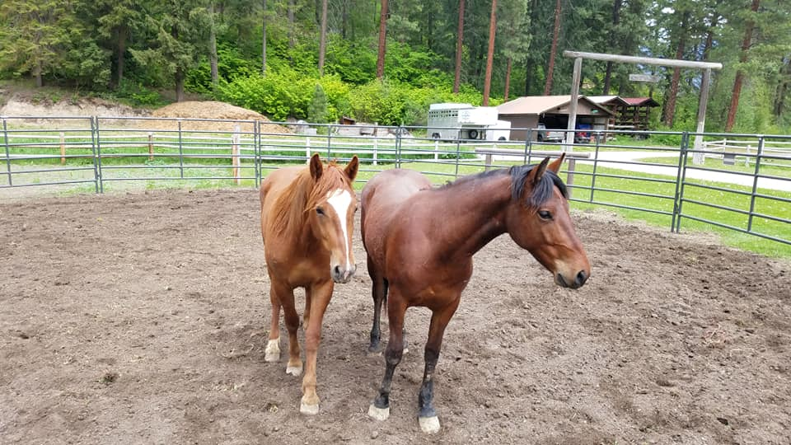
UPDATE
Summer Housing Summer team in Duplex
Variety of Teams Rural – Intercity
Local and Down Valley Chris McCormick
Property Development Grant opportunity
Serving Opportunities June 9-12 / July 23-26
Mustangs / Wildhearts
Meet Dally and Jackson

Slide 16
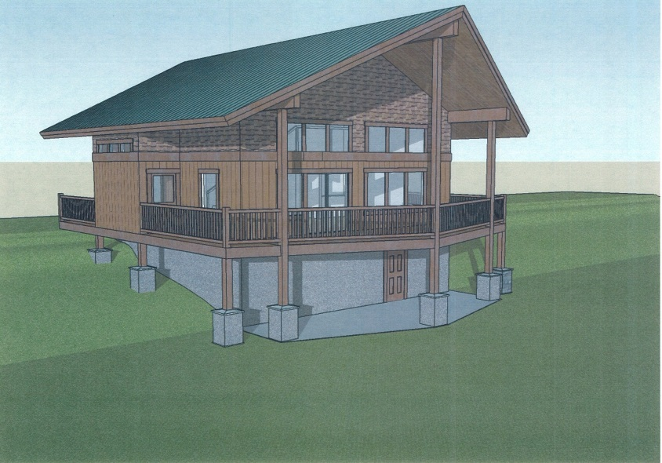
Projects in the Works

Slide 17
MINISTRY CHALLENGE
Barna Report – Reviving Evangelism
Headwinds – Cultural Changes that impact sharing our Faith
“Growing social isolation and diminishing spiritual interest do not make a friendly environment for sharing one’s faith”.
What was once searching for God (spiritual hunger) is now “looking for meaning and purpose,” – (Find what feels good)

Slide 18
CONTRIBUTING FACTORS
Belief in Self – Majority believe you find Truth by looking inside yourself = shifting from a external to a internal source of authority
Spiritual Numbness – “Our culture has been taught that self-fulfillment, sexual freedom and economic success are the highest values”
Stay in your Lane – the pressure to not offend. Attitudes toward Christianity are moving from being perceived as irrelevant to extremist.
Skepticism of Sincerity - (fake news) makes it harder to communicate heart to heart and generates suspicion of authenticity and credibility.

Slide 19
MINISTRY MINDSET
Evangelism Decline
“Sharing the gospel today is made harder by an overall cultural resistance to conversations that high-light peoples differences”
A majority of practicing Christians don’t support evangelism
47% of Millennial Christians believe it’s flat out wrong
Great Commission what? - 51% of churchgoers say they have never heard of the concept of the great commission
Mat 9:36 – “But when He saw the multitudes, He was moved with compassion for the, because they were weary and scattered , like sheep having no shepherd.”

Slide 20
MINISTRY OPPORTUNITY
Tailwinds – How can we engage?
Create Community – To nurture and sustain. People are isolated, many youth feeling empty and rejected – (award)
Relearn Conversations - To cross social divides , engage in candid talk with radical transparency (systemic issues brought to light)
Conviction and Prayer– Cultivate and pass on a deep, steady, resilient faith for the next generation of Christians in a “you do you” culture.
Be a Conduit – Be led by the Spirit and not be fearful in bearing witness to what Christ has done. (Hope)

Slide 21
“Evangelism is how we love the world, as God does, conversion is the work of the Holy Spirit. Live the truth you tell. Tell the truth you live. The rest is Gods business
~Michelle Jones
Pray for our summer teams, that we can live out Gal 5:22
“But the fruit of the Spirit is love, joy, peace, patience, kindness, goodness, faithfulness, gentleness and self control. Against such things there is no law.” 25 Since we live by the Spirit, let us keep in step with the Spirit.”

Slide 22
2 Tim 1:8 “So do not be ashamed to testify about our Lord or ashamed of me his prisoner. But join with me in suffering for the gospel by the power of God, who has saved us and called us to a holy life. Not because of anything we have done but because of his own purpose and grace.”
Matt 28:19 “Therefore go and make disciples of all nations, baptizing them in the name of the Father and of the Son and of the Holy Spirit, and teaching them to obey everything I have commanded you. And surly I am with you always, to the very end of the age.”

